Slide 1
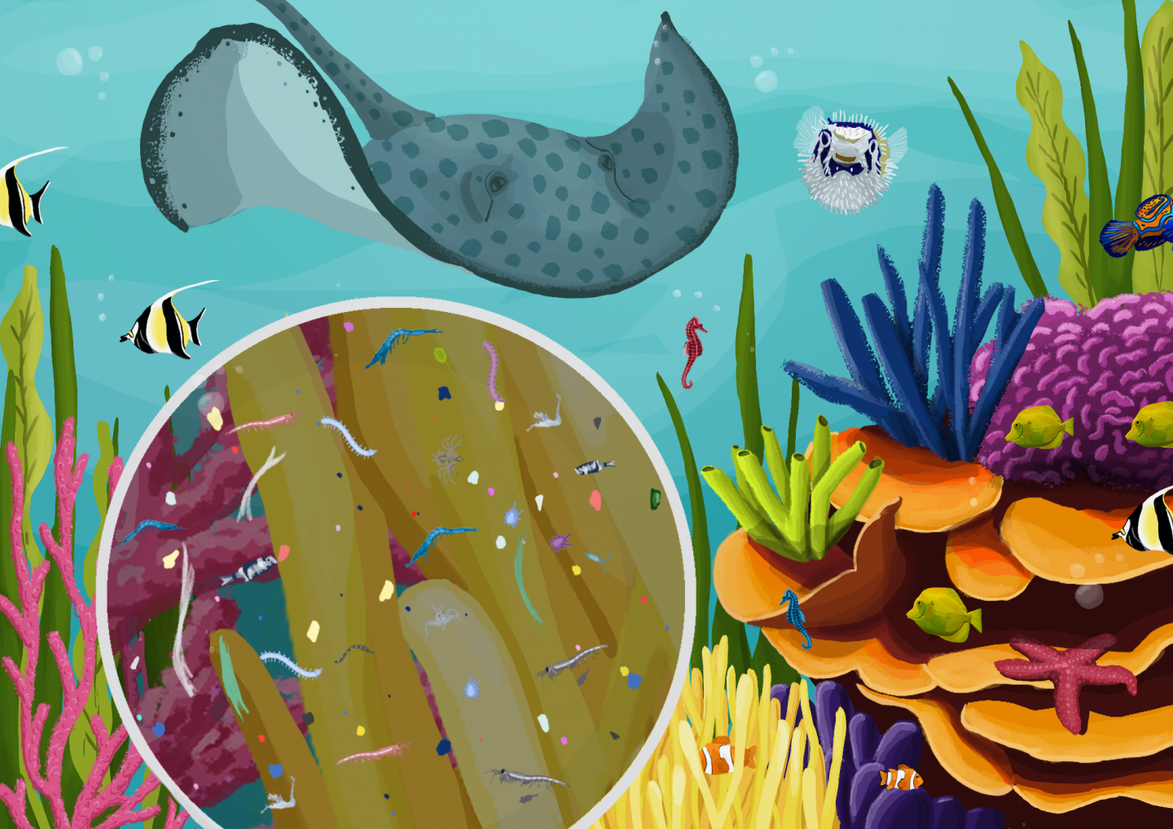
Marine Plastic Pollution
PRESENTED BY Chen Fang

Slide 2
Contents
01 Introduction
02 Sources
03 Distribution
04 Impact
05 Action

Slide 3
By 2050, there will be more plastic in the ocean than fish (by weight).
——World Economy Forum（19 Jan 2016）
Part One
Introduction

Slide 4
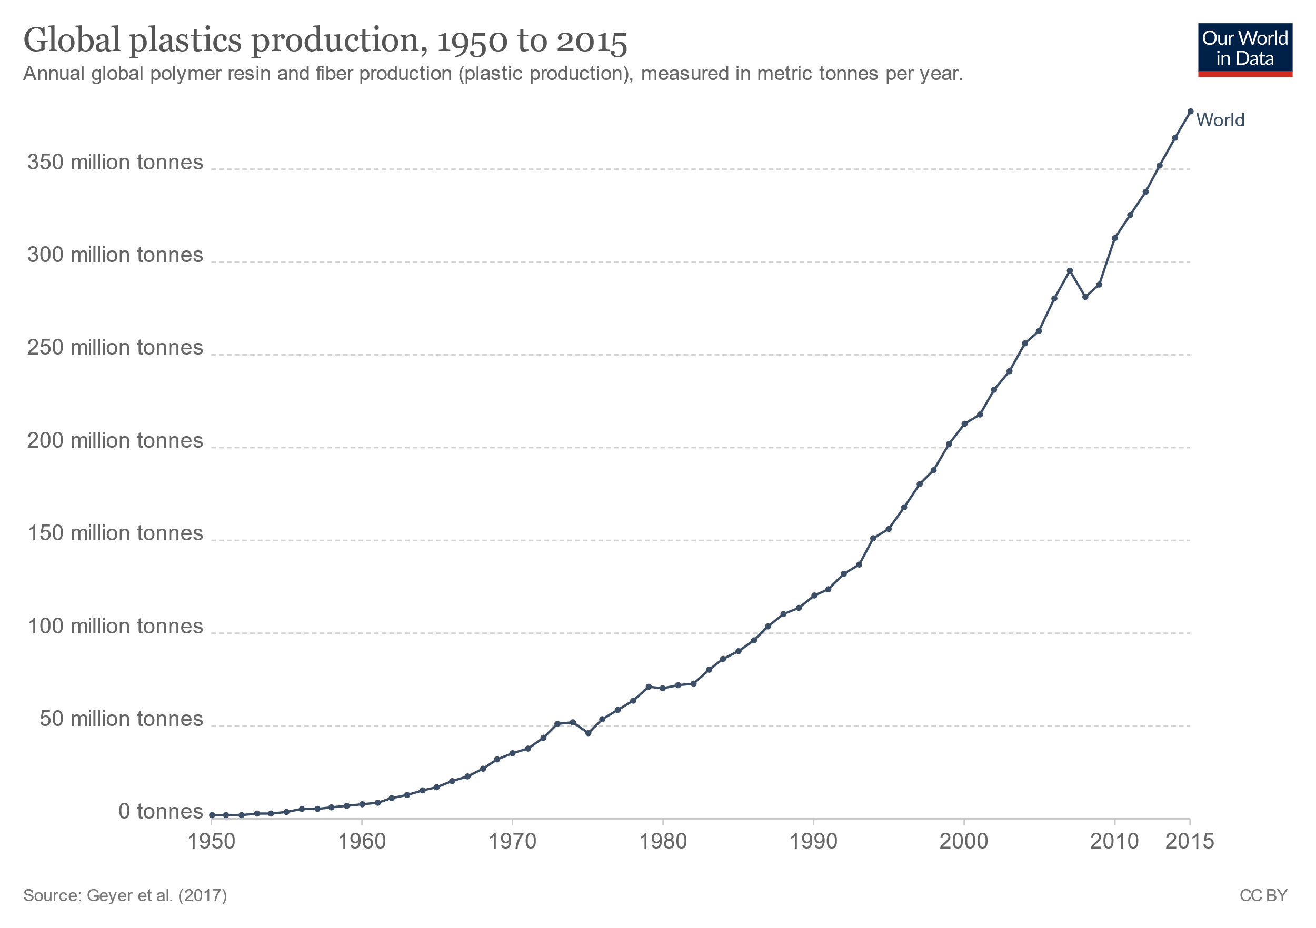
Q1
How much plastics enter the ocean every year？(in weight)
A、8 tons
B、8,000 tons
✓
C、8,000,000 tons
In 1950 the world produced only 2 million tons per year.
Since then, annual production has increased nearly 200 times, reaching 381 million tons in 2015.
Every year，8 million tons (2~3% of global annual plastics waste) of plastic enter the ocean.
https://ourworldindata.org/plastic-pollution
Notes:
数量级：order of magnitude

Slide 5
80 percent of ocean plastics come from land-based sources.
——Our World in Data
Part Two
Sources

Slide 6
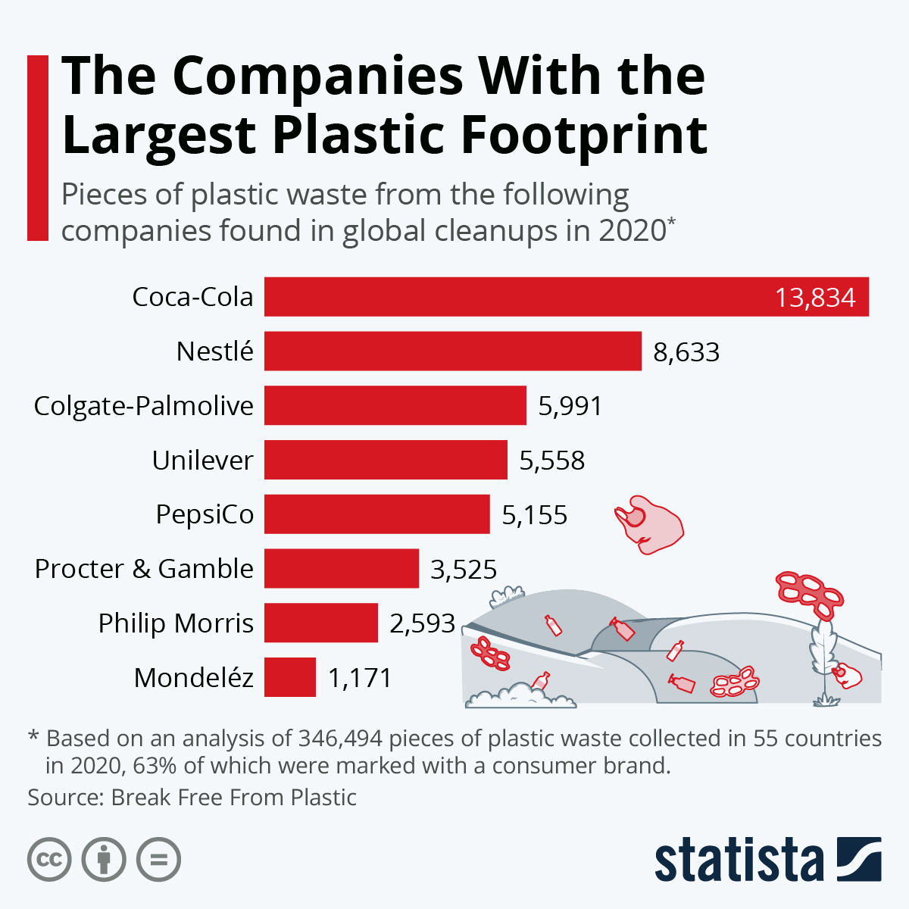
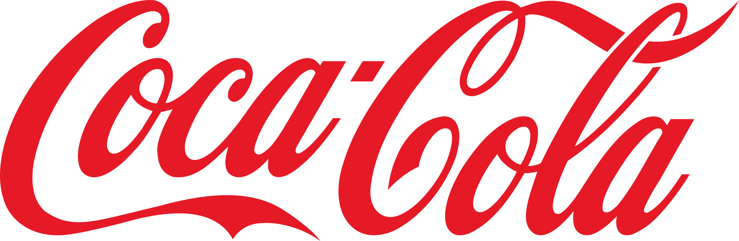


Q2
Which corporation contributes most plastic in the ocean?
Researchers collect more than 340 thousand pieces of plastic waste in 55 countries in 2020, and 63% of which were marked with a consumer brand.
A、Coca-Cola
✓
B、Nestlé
C、P&G（Procter & Gamble）
https://www.breakfreefromplastic.org/2020/12/02/top-plastic-polluters-of-2020/

Slide 7
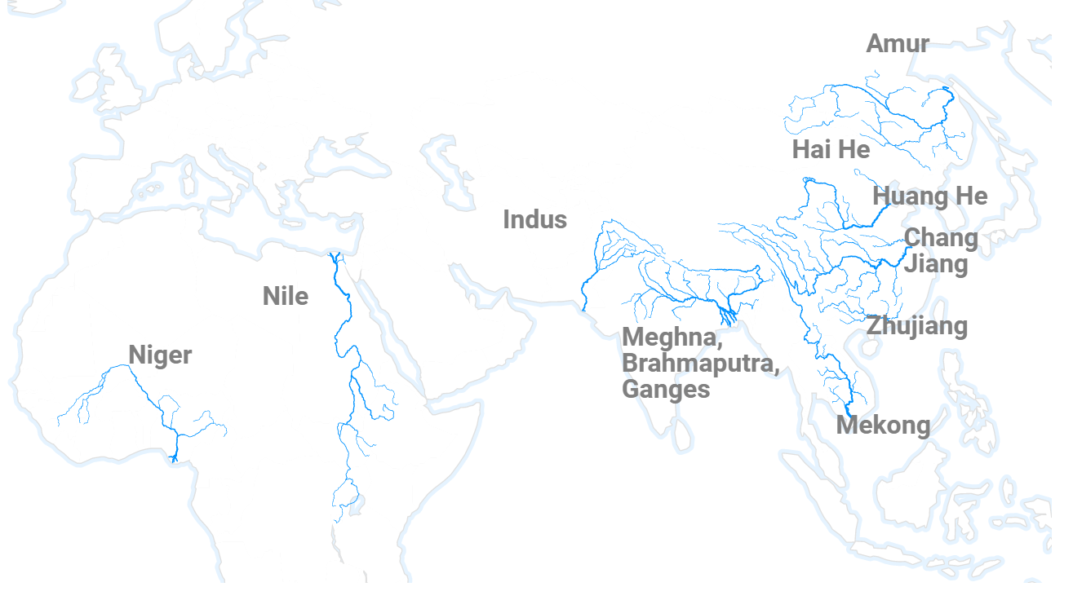
Q3
Which river transfers most plastic waste to the ocean?
✓
10 rivers alone carry more than 90% of the plastic waste that ends up in the oceans.
A、Yangtze River
B、Mekong
C、Nile
Connection
Rivers carry trash over long distances and connect nearly all land surfaces with the oceans
Population
They comprise some of the world's longest rivers, and those with large populations alongside them
The Yangtze alone dumps up to an estimated 1.5 million metric tons of plastic waste into the sea
Schmidt, C., Krauth, T., Wagner, S., 2017. Export of Plastic Debris by Rivers into the Sea. Environmental Science & Technology 51, 12246–12253.. doi:10.1021/acs.est.7b02368

Slide 8
Current can transport plastic far away from its source.
——GRID
Part Three
Distribution

Slide 9
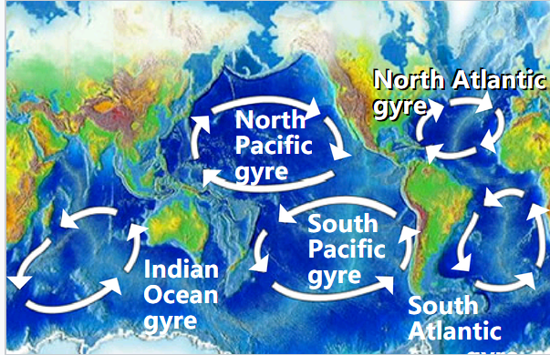
Q4
Which ocean gyre stores most plastic waste?
Gyres are large systems of circulating ocean currents.
The majority plastic will sink to the seafloor.
A small fraction arrives to one of the five great ocean gyres, where it might persist for decades.
A、North Atlantic Gyre
✓
B、North Pacific Gyre
C、South Pacific Gyre
D、South Atlantic Gyre
E、Indian Ocean Gyre
World map of the five major ocean gyres
https://en.wikipedia.org/wiki/Ocean_gyre

Slide 10
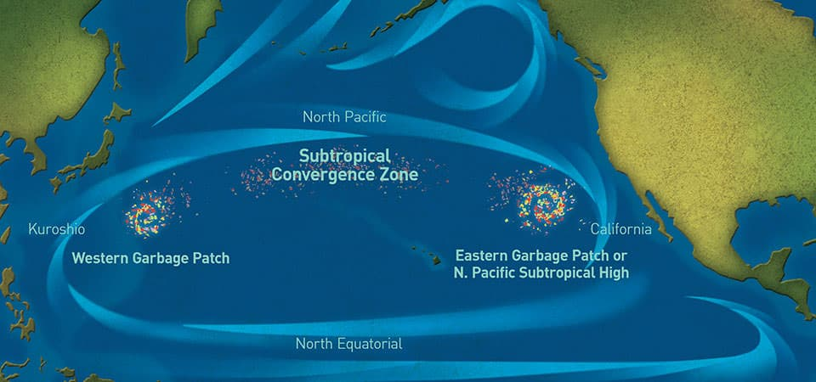
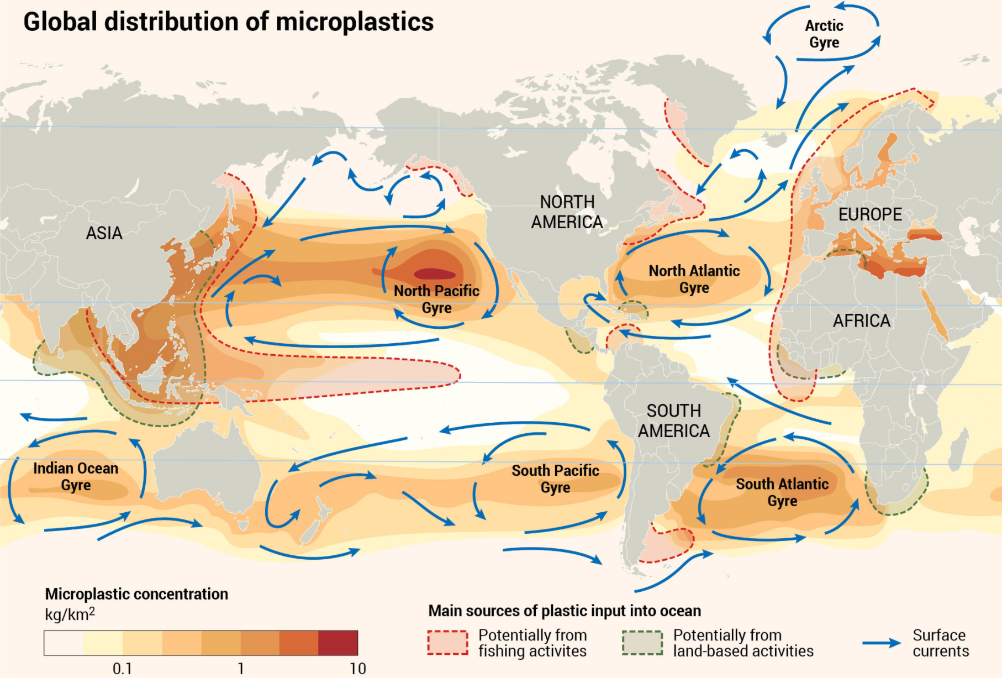
Q4
Which ocean gyre stores most plastic waste?
the Great Pacific Garbage patch located within the North Pacific Gyre
Three functions
1) Drive the so-called oceanic conveyor belt
2) Circulate ocean waters around the globe
3) Draw in the pollution that we release in coastal areas
(“take out our trash”)
https://www.newyorker.com/news/news-desk/where-does-all-the-plastic-go
https://oceanservice.noaa.gov/podcast/mar18/nop14-ocean-garbage-patches.html

Slide 11
Whale that died off Thailand had eaten 80 plastic bags.
——BBC News（2 June 2018）
Part Four
Impact
To Marine Animals & Human Beings

Slide 12
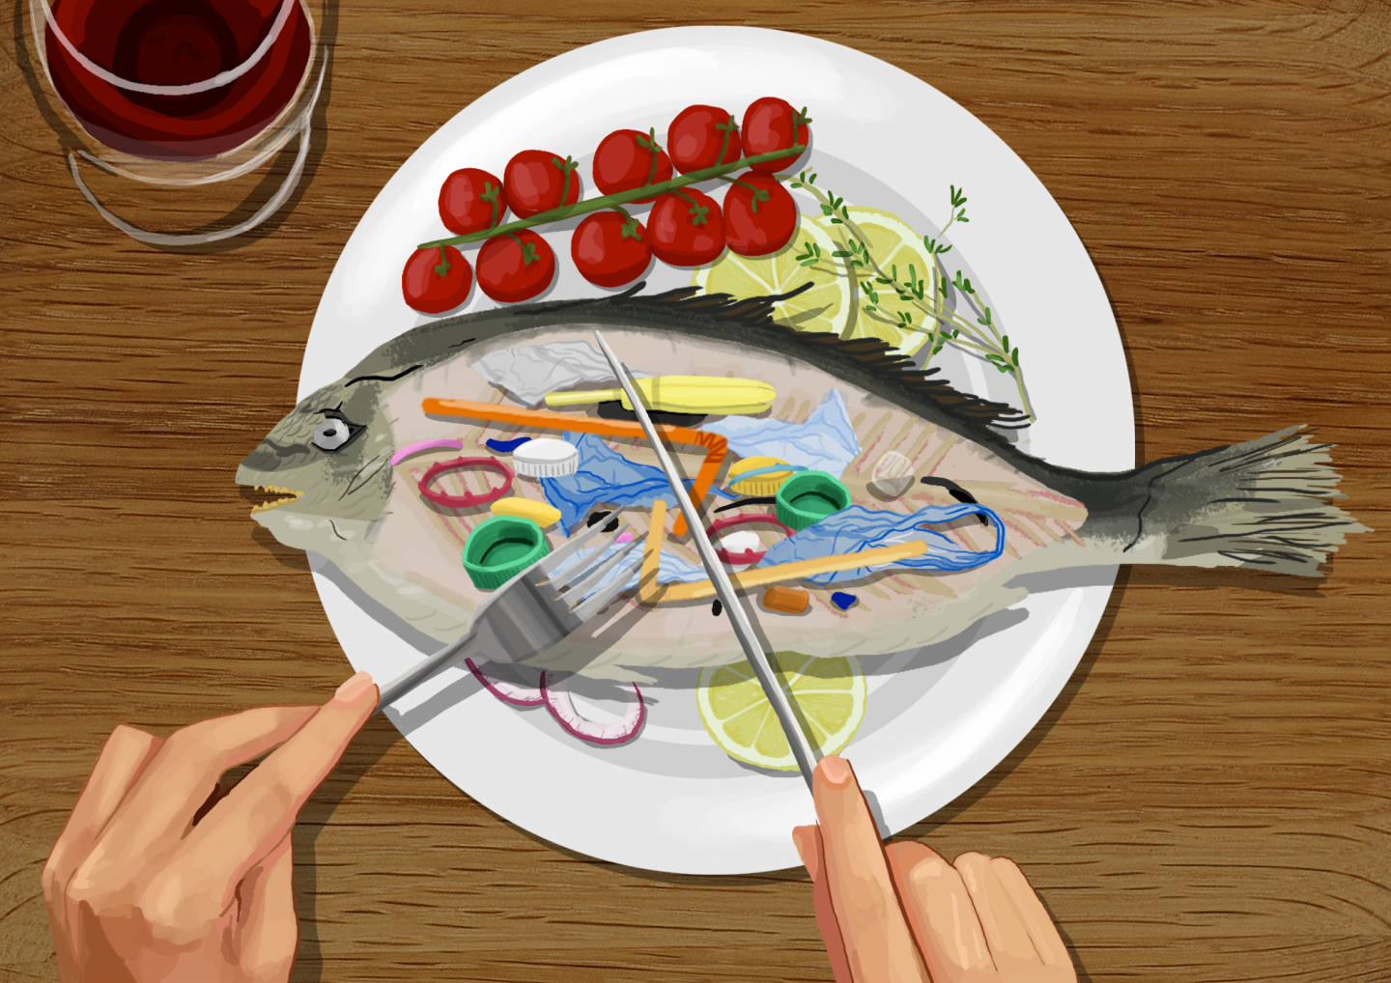
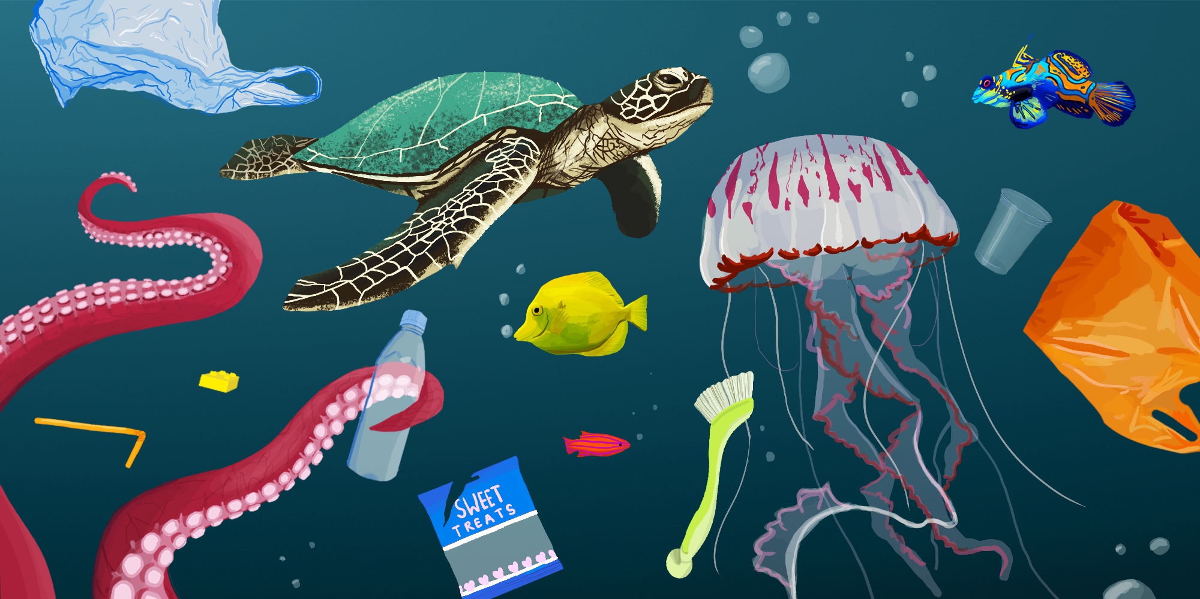
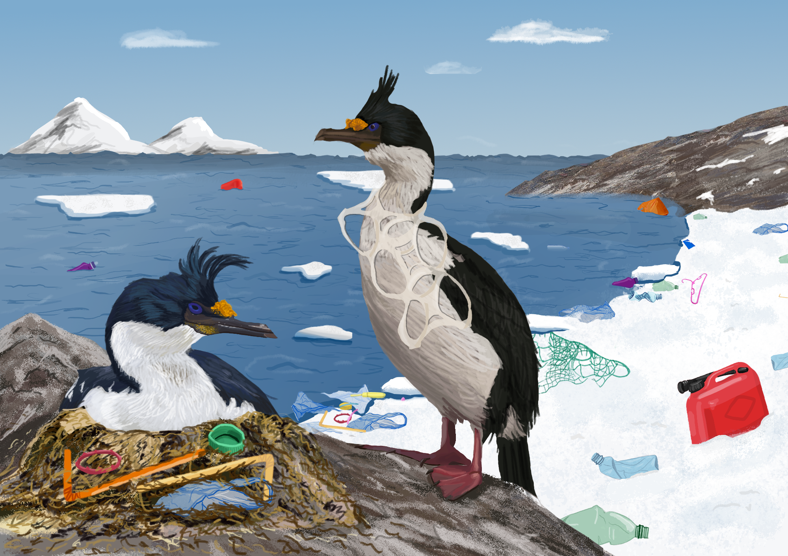
Q5
How the plastic debris impact the marine animals?
(This is an open question)
My Opinion
A、Ingestion
B、Entanglement
https://chinadialogueocean.net/14200-how-does-plastic-pollution-affect-the-ocean/

Slide 13
(Open Question)
Q5
How the plastic debris impact the marine animals?
“Ghost Fishing Gear”
Ingestion
Entanglement
Carpenter et al. (1972)
Various species of fish with plastic debris in their guts. Only white plastic spherules(球粒) had been ingested, indicating that they feed selectively.
Schrey and Vauk (1987)
Entanglement accounts for 13–29% of the observed mortality of gannets at Helgoland, German Bight.
Mattlin and Cawthorn(1986)
Young fur seals are attracted to floating debris and dive and roll about in it.
Ryan (1988)
Performed an experiment with domestic chickens to establish the potential effects of ingested plastic particles on seabirds.
Fowler, 1987; Laist(1987)
They will approach objects in the water and often poke their heads into loops and holes.
He found ingested plastics reduce meal size by reducing the storage volume of the stomach and the feeding stimulus
Weisskopf(1988)
Many seal pups grow into the plastic collars, and in time as it tightens, the plastic severs the seal’s arteries(动脉) or strangles it.
Derraik, J.G.B., 2002. The pollution of the marine environment by plastic debris: a review. Marine Pollution Bulletin 44, 842–852.. doi:10.1016/s0025-326x(02)00220-5

Slide 14
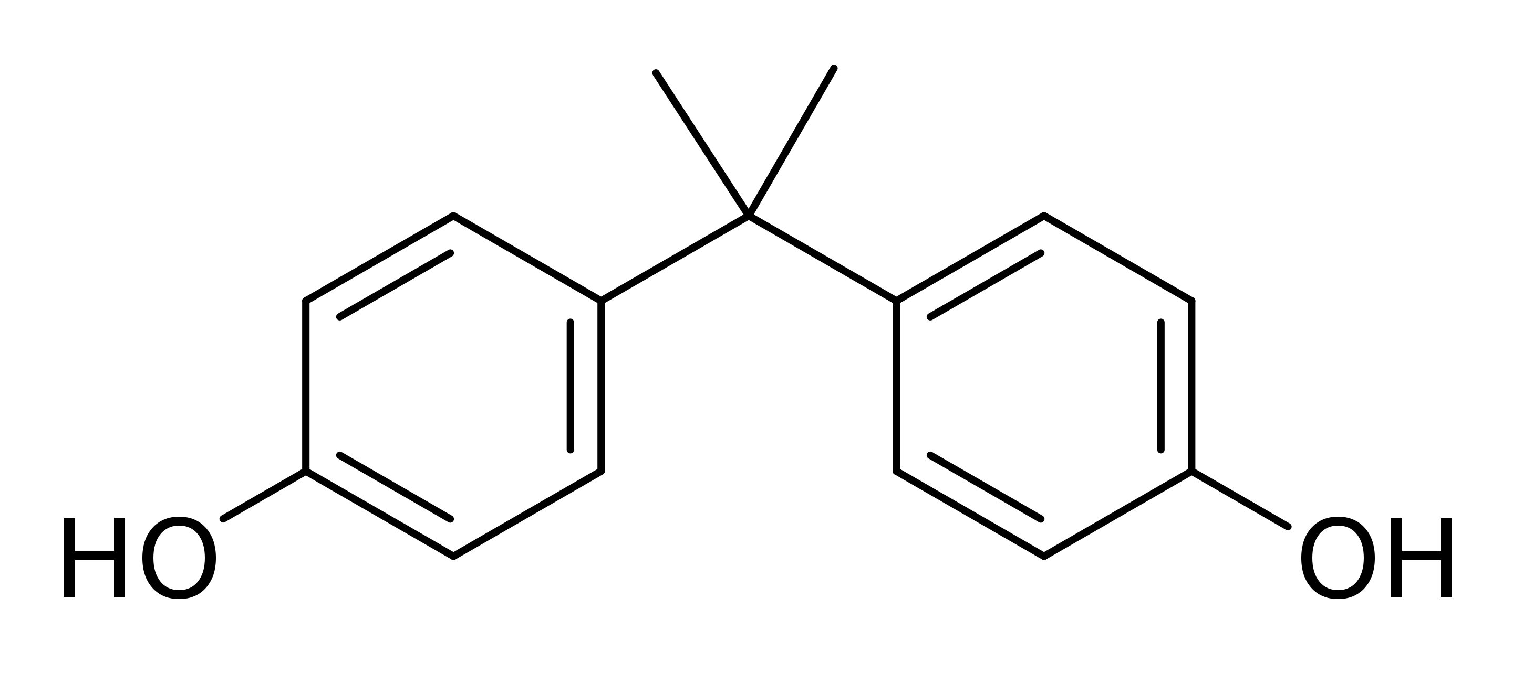
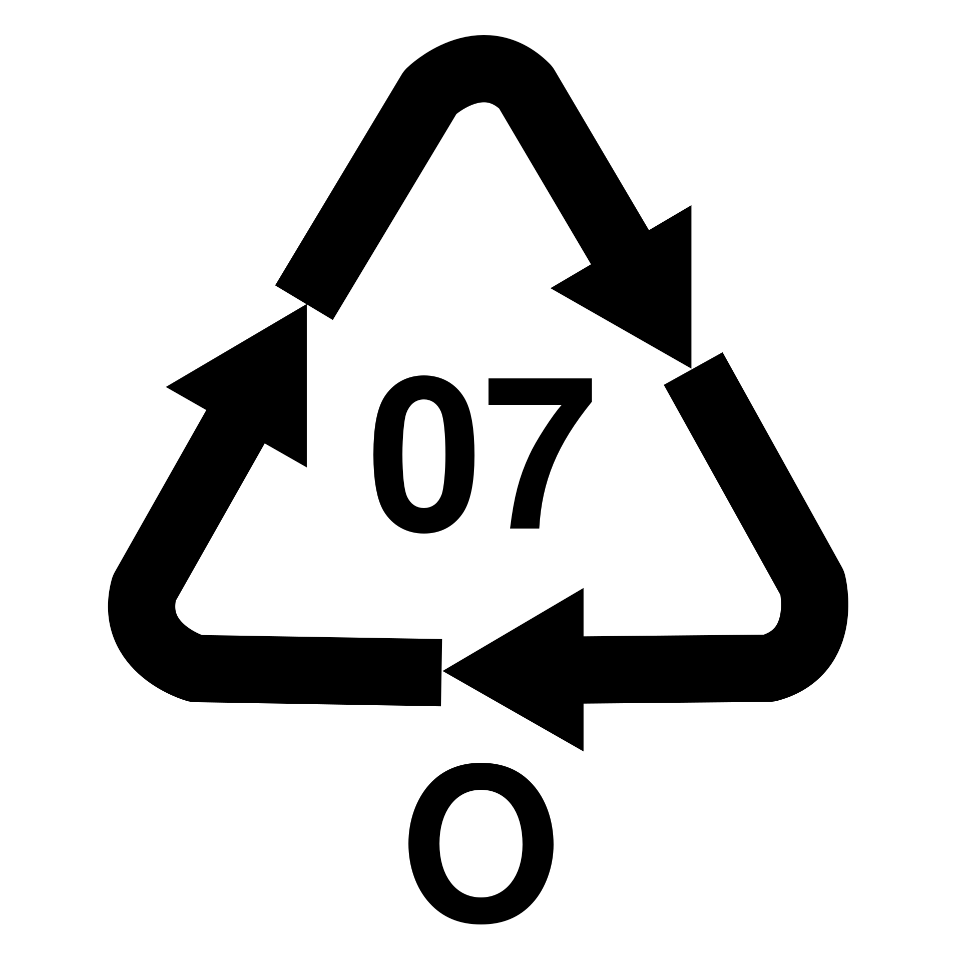
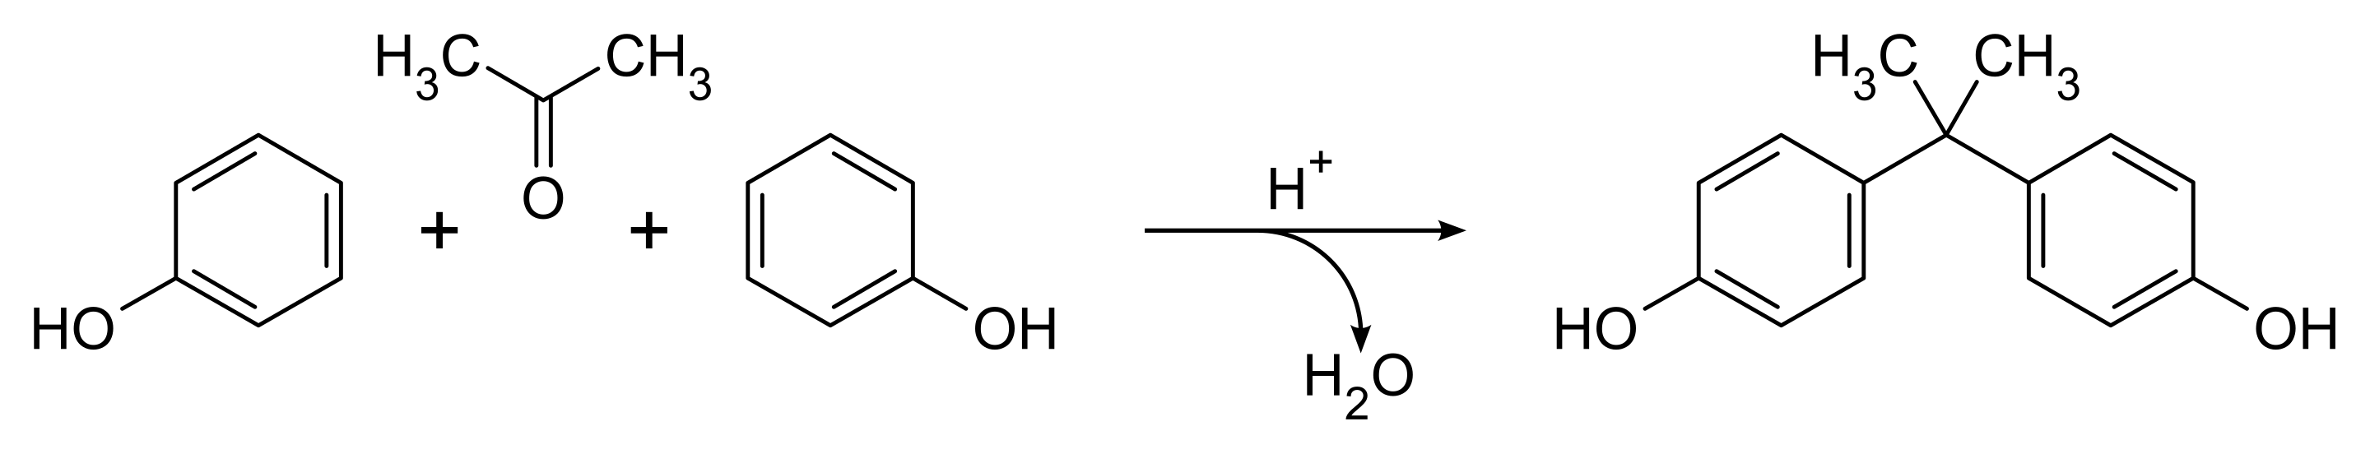
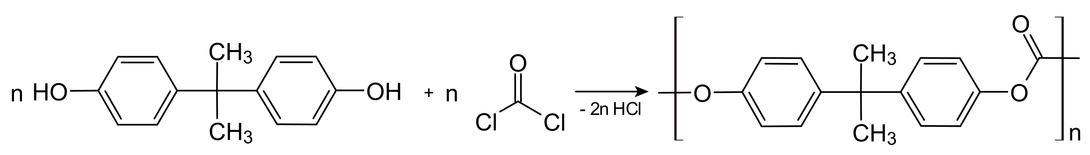
Q6
How the BPA impacts our health?
(Multiple Choice)
The largest exposure humans have had to BPA is by mouth from sources such as food packaging, metal food cans, and plastic bottles.
Bisphenol A
A、Reproduction
✓
Sex hormone concentrations
Reduced sperm quality
Male sexual function
Breast cancer
This compound is synthesized by the condensation of acetone with two equivalents of phenol.
✓
B、Development
Male genital abnormalities
Childhood asthma
✓
C、Metabolic disease
Type-2 diabetes
Obesity
Cardiovascular disease
Bisphenol A is a precursor to polycarbonate plastics.
https://en.wikipedia.org/wiki/Bisphenol_A
Rochester J R. Bisphenol A and human health: a review of the literature[J]. Reproductive toxicology, 2013, 42: 132-155.

Slide 15
“The science we need for the ocean we want”
——the motto of UN decade of ocean science
Part Five
Our Action

Slide 16
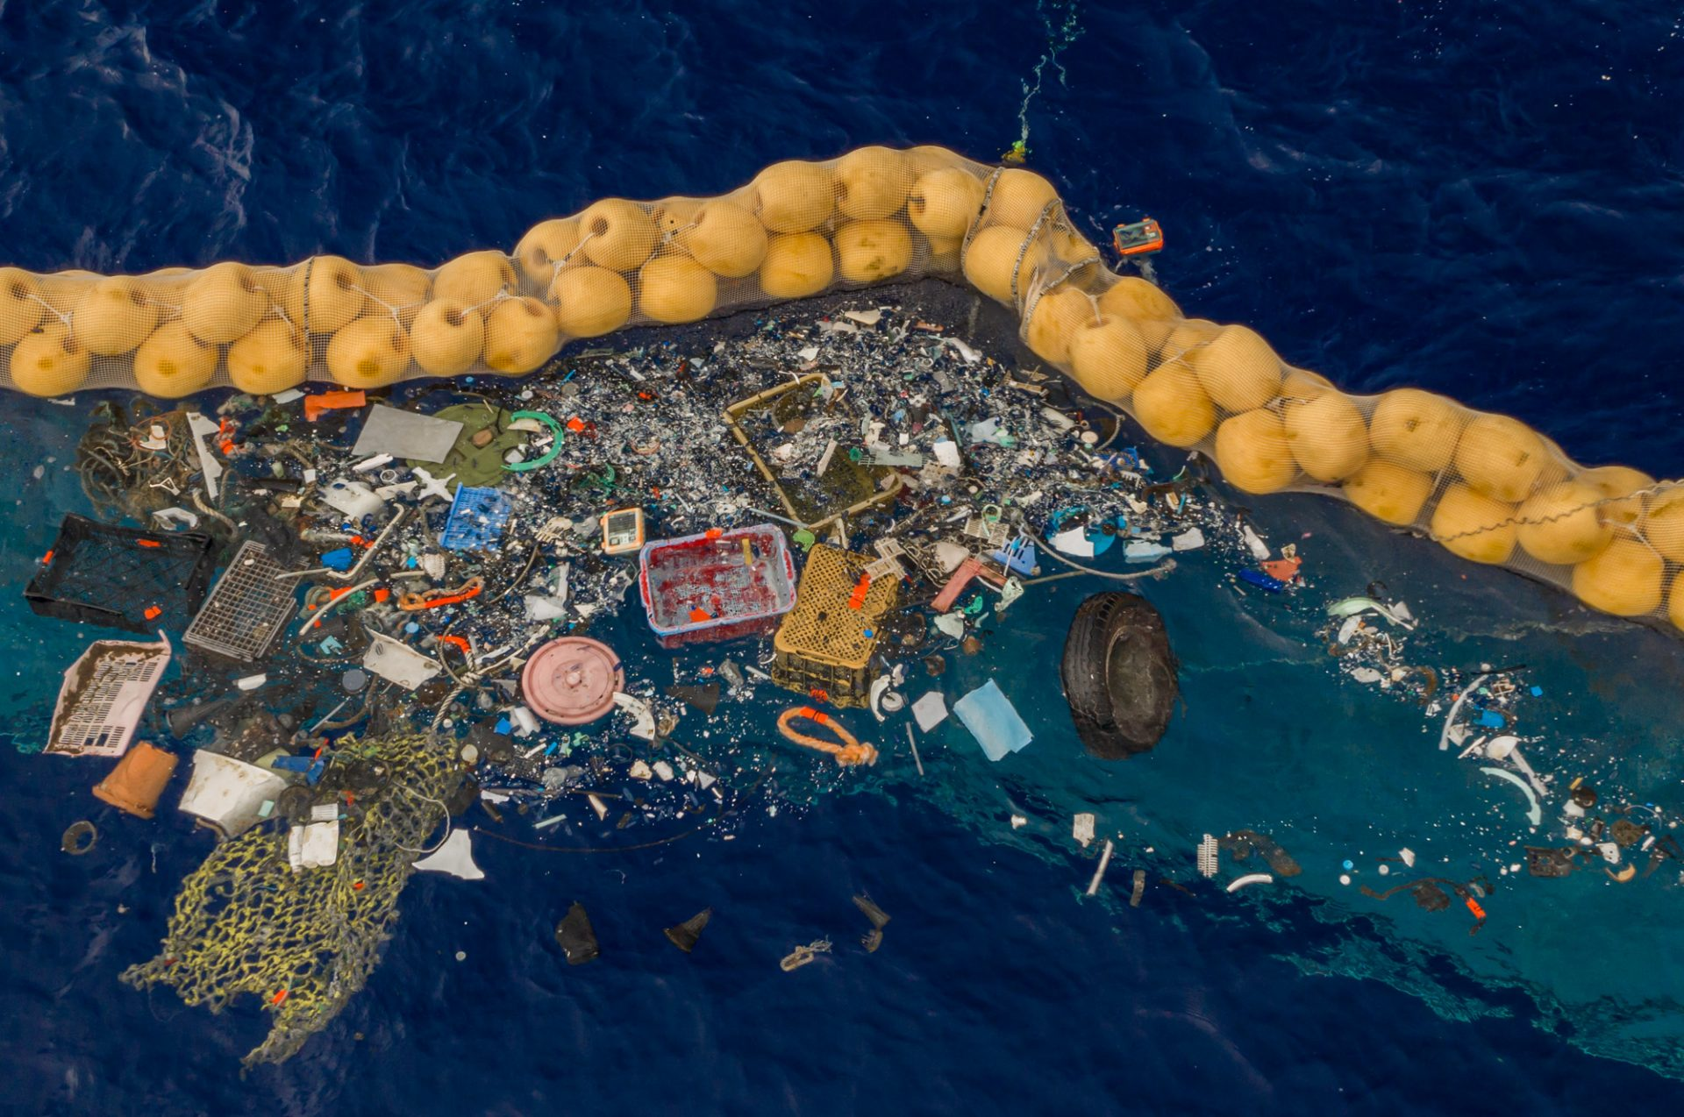
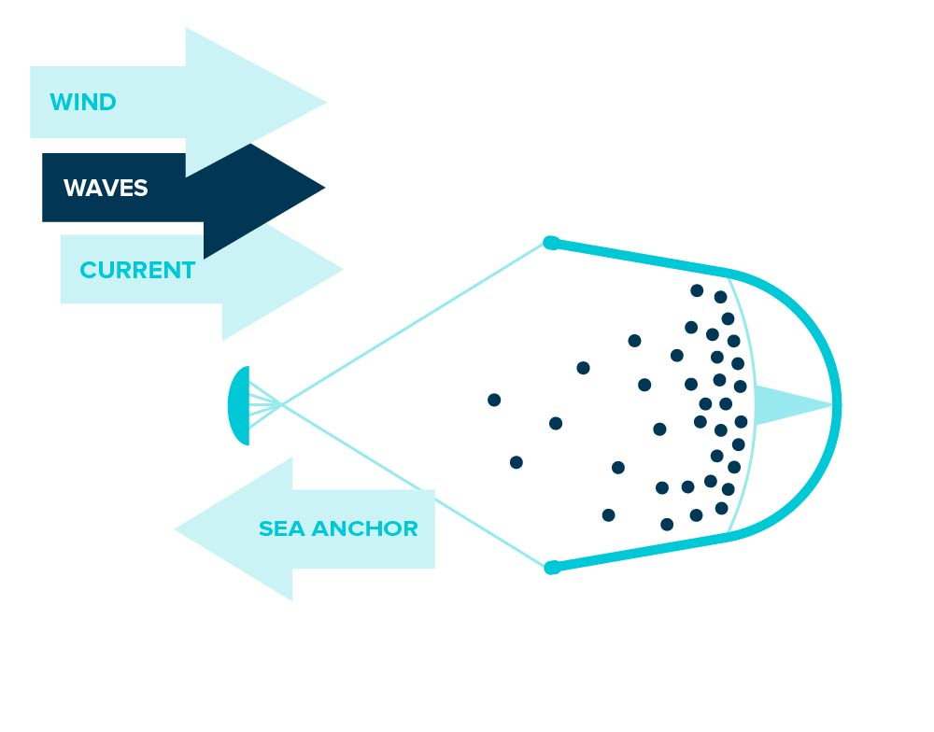
Q7
What can we do to prevent marine plastic pollution？
Engineering
The Ocean Cleanup has invented a huge floating boom that siphons plastic waste out of the Great Pacific Garbage Patch.
Create a coastline where there are none
Take advantage of natural oceanic forces
A long floater sits at the surface of the water
A skirt hangs beneath it
Both the plastic and system are being carried by the wind, waves and current.
Using a sea anchor to slow down the system, plastic can be retained and captured.
https://theoceancleanup.com/oceans/

Slide 17
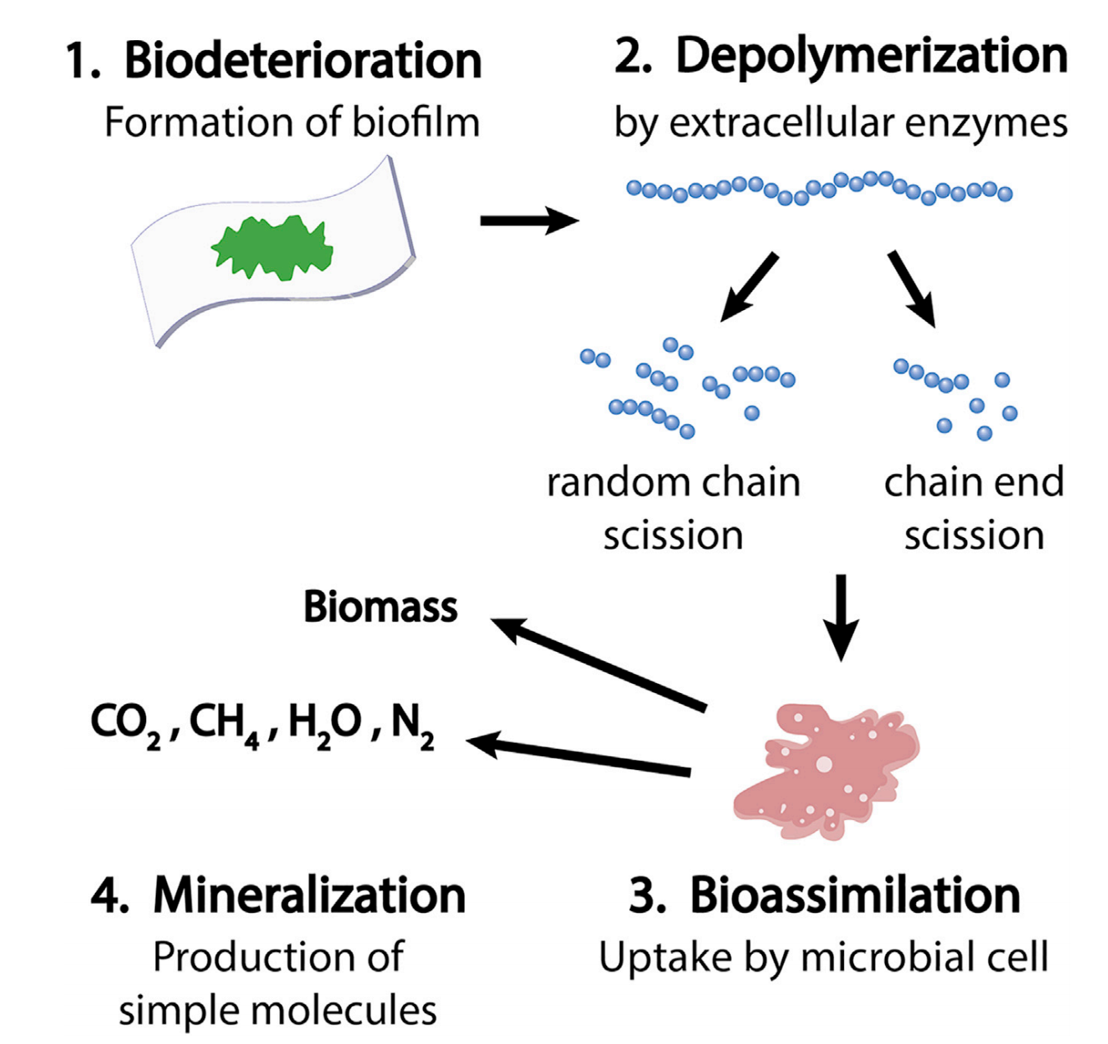
Q7
What can we do to prevent marine plastic pollution？
Technology
Biodegradation Mechanism
Ocean-friendly materials
A group of researchers from Osaka University combined biomasses starch and cellulose to develop a marine biodegradable plastic.
First stage: Hydrolysis
Polymers are ultra-long molecules, but they are shredded by breaking ester bonds by enzymes produces by bacteria.
Second stage: Bacterial decomposition
Bacteria eat the finer parts and decompose them into [water] and [carbon dioxide] and disappear.
However, there are very few bacteria in seawater, so it can be said that it is a very difficult environment for biodegradation.
https://www.eurekalert.org/pub_releases/2020-03/ou-mtd032220.php
Barron, A., Sparks, T.D., 2020. Commercial Marine-Degradable Polymers for Flexible Packaging. iScience 23, 101353..

Slide 18
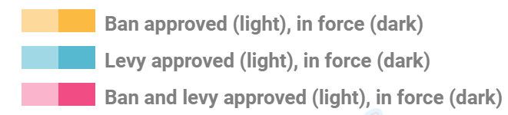
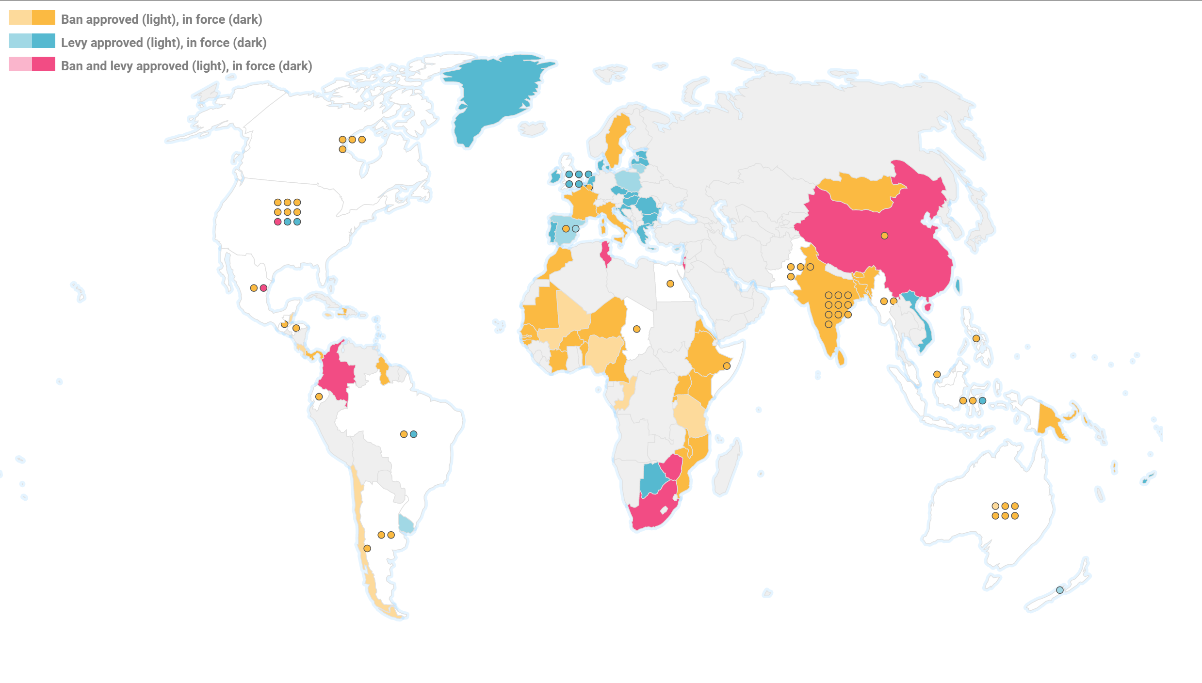
Q7
What can we do to prevent marine plastic pollution？
Policy
China’s Time Schedule
2020
Non-degradable plastic bags will be banned in places such as supermarkets and shopping malls in major cities.
2022
Significantly reduce the use of disposable plastic in e-commerce, express deliveries and takeaway food
2025
Establish a system for producing, distributing, consuming, recycling and disposing of plastic products.
Source: “Banning single-use plastic: lessons and experiences from countries” UN Environment report (2018)

Slide 19

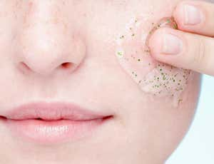
Q7
What can we do to prevent marine plastic pollution？
Individual
Change your life style
“A papery or cardboard-like flavor from the straw”
9 ways to reduce your plastic use：
“A chemical taste from the glue used to manufacture it”
1. Carry a reusable bottle
“Spoil the flavor of your milkshake or cocktail”
2. Say no to plastic straws
3. Take a reusable coffee cup
Microbeads get washed into the drain and are too small to be filtered out.
They enter our waterways and wind up in lakes and streams and in the tummies of unsuspecting fish.
4. Avoid excessive food packaging
5. Use refill stations for detergents
6. Say no to disposable plastic cutlery
7. Get your milk delivered
8. Avoid microbeads
9. Carry a shopping bag
https://www.twowanderingsoles.com/blog/simple-ways-to-reduce-plastic-use
https://www.greenpeace.org.uk/news/9-ways-reduce-plastic-use/

Slide 20
THANK YOU
FOR WATCHING
2021/7/16
Reporter：Chen Fang

